Slide 1


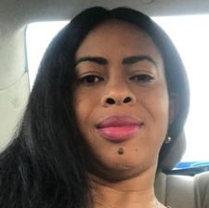
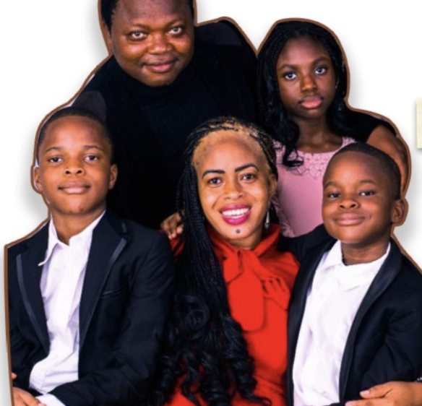
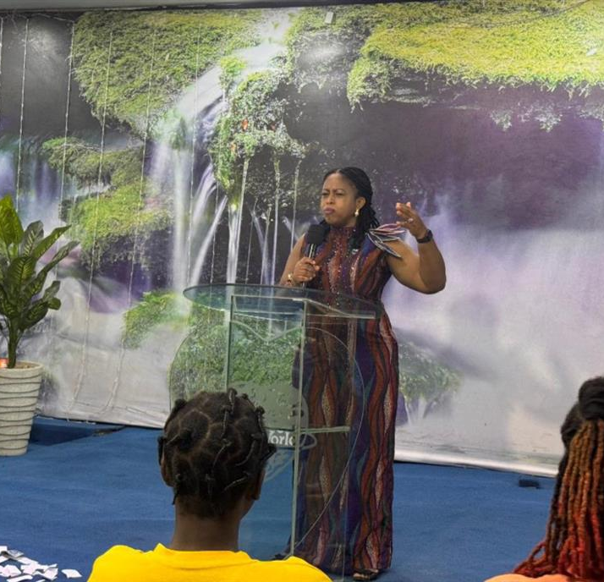
Getting to Know Me
Work
Personal
My role
Country HR manager
Significant others / family members / furry friends in my life
Mum, Husband and 3 Kids
Tenure in ofi/Olam
3 years, 5 Months and 3 days
How I enjoy spending my free time
Spending Time with Family and personal Meditation
Previous companies I have worked at
Promoasidor Nigeria Limited, Servipower Nigeria Limited
My favorite / comfort food
Fried rice and Turkey
Why I joined ofi/Olam and what keeps me here?
Passion for Growth
My favorite song
Alabaster Box by Cece winners
Ulari Agundu
‘what name you prefer to be called’
Ulari
This is me outside work, doing stuff I enjoy in my life …
A few fun facts about me
I love spending time with Family, and I enjoy shopping

